Slide 1



LIBRARY MANAGEMENT SYSTEM
2025

Slide 2

INTRODUCTION
The library management system is designed to assist librarians and users in educational institutions, such as schools and universities, in efficiently managing library activities. Compared to manual methods using pen and paper, this system stores data in a computer database, reducing time and effort while minimizing errors. This project, implemented using Java with MS Access, is an ideal choice for final-year students, as it not only enhances programming skills but also strengthens personal portfolios.

Slide 3
FEATURES AND BENEFITS
The system offers several key features, including:
Searching for books by title or author, displaying relevant results instantly.
Managing book categories, adding/deleting/editing details such as title, author, and publisher.
Recording and tracking borrowing/return transactions, including calculating late return fines.
Generating reports on book inventory, borrowed books, and revenue from fines.
The benefits include time savings, increased efficiency for librarians, and easier book searching for students. Notably, the system helps reduce paperwork and labor costs while improving the user experience with mobile access and email reminders.

Slide 4
DETAILED SURVEY NOTES
The library management system, developed using Java with an MS Access database, is a technological solution designed to improve library efficiency in educational institutions, particularly schools and universities. Below is a detailed analysis based on reliable sources, covering features, technical implementation, benefits, and challenges to provide a comprehensive view of this project.

Slide 5
BACKGROUND AND OBJECTIVES
Traditional library management relies on manual methods, using pen and paper to record details such as book inventory, categories, titles, and student borrowing/returning records. This approach is time-consuming, labor-intensive, and prone to errors. This project
aims to address these challenges by automating operations through a computerized database, enhancing library efficiency.
The main objectives include:
Automating the recording and management of books, members, and borrowing/return transactions.
Providing a user-friendly interface for quick book searches without manual effort.
Ensuring accuracy and reducing errors compared to manual methods.
This project is well-suited for final-year students, not only for its practical application but also for enhancing personal portfolios, particularly in Java programming and database management.

Slide 6
KEY FEATURES
Based on research from sources like GeeksforGeeks Library Management System, this system offers the following features:
Book Catalog Management: Add, delete, and edit book details, including title, author, publisher, publication date, price, and purchase date.
Book Search: Users can enter a book title or author, and the system will display relevant books, saving time compared to manual searching. This is one of the most notable features, especially useful for students and faculty.
Borrowing/Returning Management: Records book borrowings, return dates, and calculates late return fines based on book categories and membership types.

Slide 7
KEY FEATURES
Member Management: Add, delete, and edit student/faculty information, including borrowing history and account status.
Reports and Statistics: Generate reports on book inventory, borrowed books, overdue books, and revenue from fines, aiding management decisions.
OPAC (Online Public Access Catalogue) Interface: Allows users to search books online, check account status, and reserve books, enhancing user experience.
Additionally, the system can integrate barcode or RFID technology for book scanning during borrowing/returning, as suggested by MasterSoft Library Management, increasing efficiency and accountability.

Slide 8
TECHNICAL IMPLEMENTATION
The system is developed using Java due to its platform independence and object-oriented features, making it suitable for multi-platform applications (Windows, Linux, macOS, etc.). MS Access is chosen as the database for its ease of use, lack of complex server requirements, and suitability for small to medium-sized libraries.
According to Code With C Library Management System, the technical implementation includes:
Using JDBC-ODBC bridge or the UCanAccess library to connect Java with MS Access, ensuring communication between the application and the database.

Slide 9
TECHNICAL IMPLEMENTATION
The user interface can be built with Java Swing for a standalone application or JSP for a web version, supported by tools like NetBeans 5.0 and Tomcat 5.5.
Minimum hardware requirements: Pentium III 630MHz processor, 128MB RAM, 20GB hard drive; software: Windows NT/98/XP OS, JRE, and MS Access.
However, MS Access has scalability limitations when handling large amounts of data, which can cause performance slowdowns, especially for libraries with thousands of books and transactions.

Slide 10
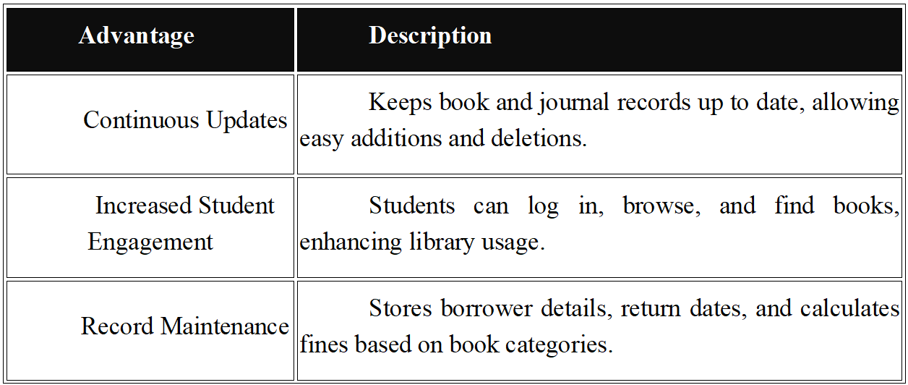
ADVANTAGES OVER MANUAL SYSTEMS
Compared to traditional manual methods, this system offers numerous advantages, as highlighted by Entab Library Management Benefits:

Slide 11
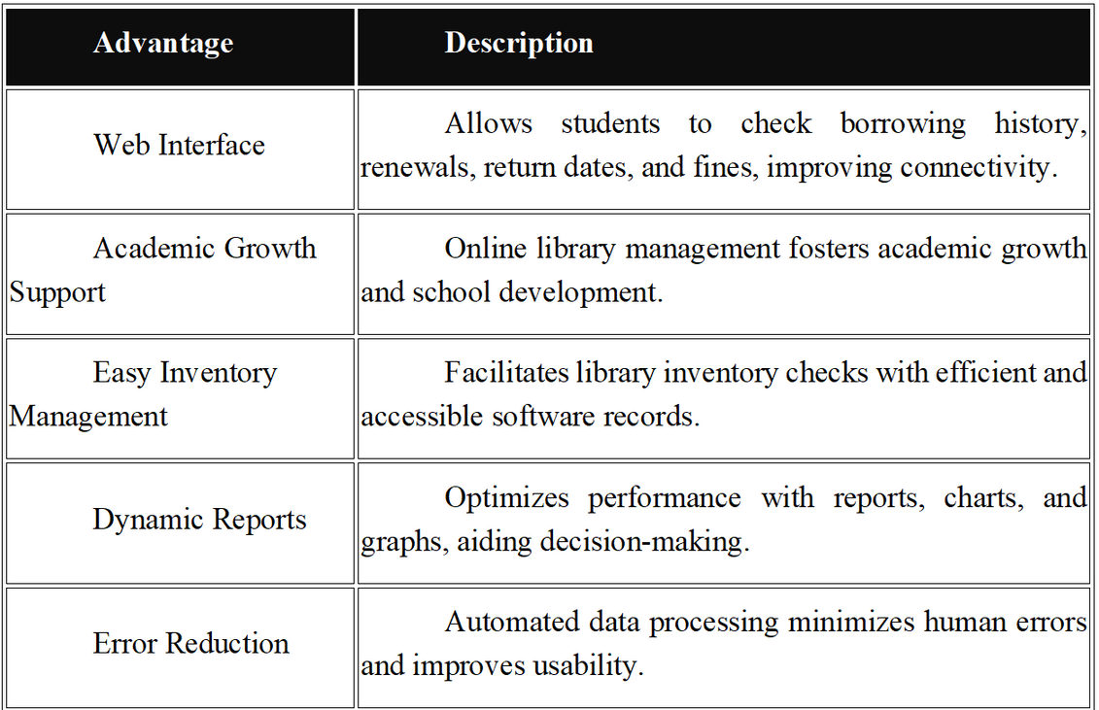
ADVANTAGES OVER MANUAL SYSTEMS

Slide 12
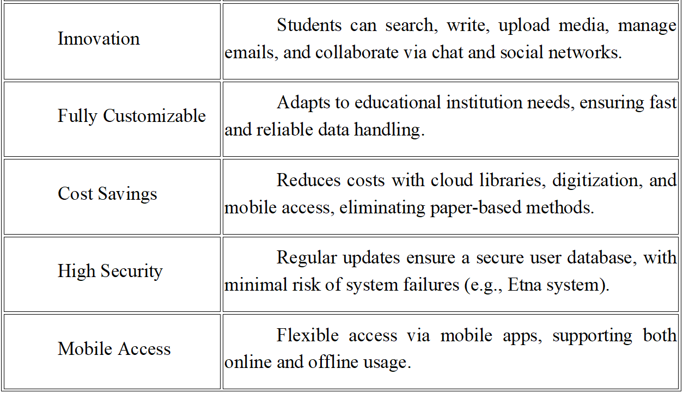
ADVANTAGES OVER MANUAL SYSTEMS

Slide 13
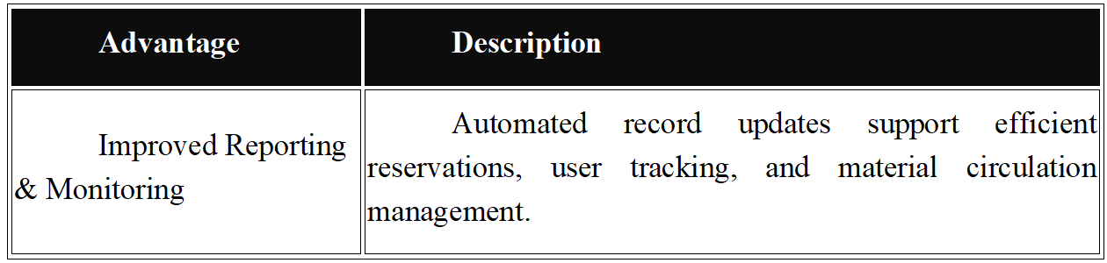
ADVANTAGES OVER MANUAL SYSTEMS
These benefits not only improve librarian efficiency but also support students and faculty in academic research.

Slide 14
CHALLENGES AND FUTURE DEVELOPMENT
Despite its advantages, MS Access has scalability limitations, particularly when handling large amounts of data, which may cause performance issues. Other challenges include:
Difficulty in integrating with larger systems or those requiring high security.
Lack of built-in mobile support, requiring additional development for a mobile application.
In the future, the system can be upgraded by:
Migrating to a more robust database like MySQL or PostgreSQL for better scalability.
Integrating a mobile application to allow users to access the system anytime, anywhere, with email or SMS notifications for return dates.
Adding data analytics features, such as book borrowing trends by category, to support library management decisions.

Slide 15
CONCLUSION
The library management system, developed using Java and MS Access, is an efficient solution for educational libraries, automating and optimizing operations. With features like quick book searches, borrowing/return management, and report generation, along with benefits such as cost savings and increased efficiency, this project is ideal for final-year students. However, scalability limitations should be considered, and future upgrades should be planned to accommodate growth.

Slide 16
PROJECT OVERVIEW
LMS is a software application useful for librarians in any educational institution for management and handling of typical operations in the library. It manages data through computerized system in a database which eradicates the tediousness in searching a particular book in the entire library.
Existing System: The existing library management system is very traditional and manual. Most of the things such as record of students who’ve issued the book, no. of books in the library, fine of students, etc. are recorded using pen-paper system. This traditional system requires a lot of time and manpower for performing simple operations in the library.

Slide 17
PROJECT OVERVIEW
The drawbacks of existing system are:
Record keeping is paper-based.
The system is not computerized.
There’s high risk of data mis-management.
Students face a lot of problem while searching a book.
Chances of book theft from the library is high.
A lot of paperwork and manpower is to be allocated for simple library management operations.
The existing system is very inefficient and unreliable.

Slide 18
PROJECT OVERVIEW
Proposed System:
The proposed library management software is developed after the analysis of issues, problems, and drawbacks of the existing system. Here, different modules have been assigned for managing and organizing different tasks in a library. Using this software, librarian can store information of all the books, with author name, faculty, etc., available in the library. Only one person can handle the entire library.
The main feature of this system is that all the books available in the library can be displayed in a list so that students need not roam through the entire library to find a book.

Slide 19
PROJECT OVERVIEW
Additionally, the application effectively maintains the details of users/students to whom books have been issued; it also records the issued date and return date.
Features:
Add, modify and delete book details into the database. Search feature for finding book availability in library stock. Add students records upon issue of a book. Record issue date, return date, and fine (penalty). Payment system/feature allows the librarian to calculate payment details and print bill.

Slide 20
PROJECT OVERVIEW
Technologies and Products Used:
NetBeans 5.0
Tomcat 5.5 embedded in NetBeans
Oracle10g Express Edition
Jboss 4.0.3
Java Server Pages (JSP)
Java Beans
Enterprise Java Beans

Slide 21
PROJECT OVERVIEW
Modules Overview:
Insertion Module: With the help of this module, librarian can insert information and details of users along with book details and time and date of book issue.
Updating Module: This module allows modification to the existing records and details in the library management system database.
Report Generation Module: This module allows task such as printing payment details, stock details of books, etc

Slide 22
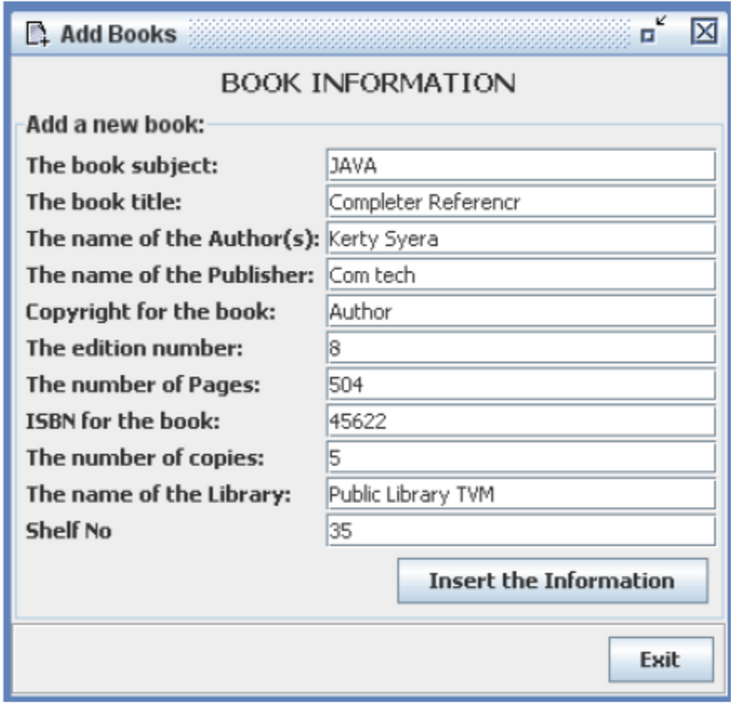
PROJECT OVERVIEW
Screenshots:
Add new books

Slide 23
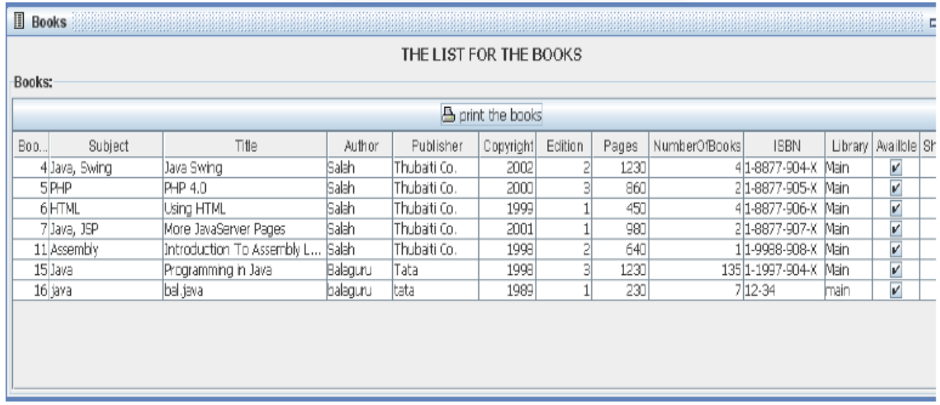
PROJECT OVERVIEW
Screenshots:
List of All Books

Slide 24
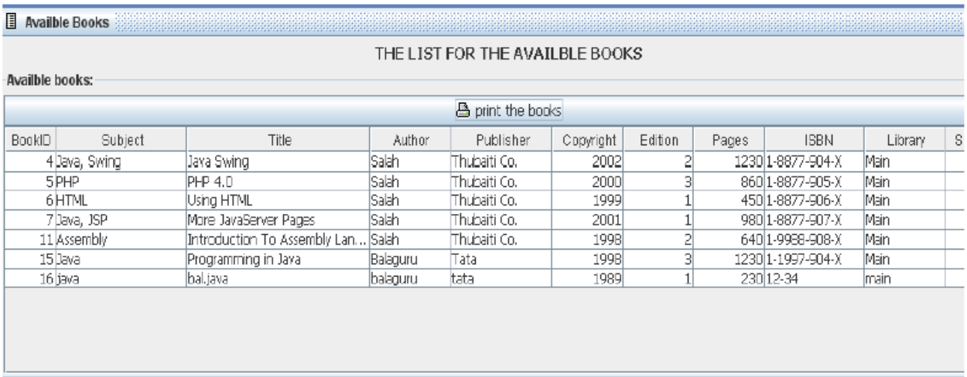
PROJECT OVERVIEW
Screenshots:
Available Books

Slide 25
PROJECT OVERVIEW
System Configuration:
Hardware Configuration:
Processor: Pentium III 630MHz
RAM: 128MB
Hard Disk: 20GB
Monitor: 15″ Color Monitor
Keyboard: 122 keys
Software Configuration:
Operating System: Windows NT/ Windows 98/ Windows XP
Language: Java 2 Runtime Environment
Database: MS Access

Slide 26
GIT AND GITHUB OVERVIEW
What is Git?
Git is a powerful and widely adopted Distributed Version Control System (DVCS), celebrated as the de facto standard for managing source code and project versions in the software development community. Unlike centralized version control systems that rely on a single server to store all changes, Git distributes the full repository—including the entire history of modifications—to every developer’s local machine. This decentralized architecture empowers individuals and teams to work independently, collaborate seamlessly, and maintain robust version control, even in offline environments. Originally created by Linus Torvalds in 2005 to support Linux kernel development, Git has since evolved into a cornerstone tool for projects of all sizes, from solo endeavors to massive open-source collaborations.

Slide 27
GIT AND GITHUB OVERVIEW
What is Git?
Git’s popularity stems from its speed, flexibility, and ability to handle complex workflows. Each developer’s local repository acts as a self-contained unit, containing not just the current state of the project but also every change ever made, complete with metadata like timestamps, authors, and commit messages. This design ensures that developers can experiment, track progress, and recover from mistakes without relying on constant server connectivity, making Git a versatile and resilient solution for modern software engineering

Slide 28
GIT AND GITHUB OVERVIEW
What is a Version Control System (VCS)?
A Version Control System (VCS) is a software framework designed to systematically track, manage, and store changes to a project’s files—most commonly source code—over time. It acts as a digital ledger, preserving every modification in a structured manner and enabling developers to navigate the evolution of their work. VCS tools are essential in software development, where files are frequently updated, shared, and iterated upon by multiple contributors. By maintaining a comprehensive history of changes, a VCS allows developers to create distinct versions of a project, each representing a snapshot or milestone in its development lifecycle.
At its core, a VCS operates by storing all project files in a repository—a centralized or distributed storage location. Developers can clone this repository to their local machines,

Slide 29
GIT AND GITHUB OVERVIEW
What is a Version Control System (VCS)?
make changes independently, and commit those changes to create new versions. These updates can then be pushed to a shared server, where other team members with appropriate permissions can pull the latest revisions or even clone the entire repository anew. Each version in the VCS includes critical details: the altered content, the date and time of the change, the identity of the contributor, and often a note explaining the purpose or context of the modification. This timeline-like structure allows developers to review past states, compare differences, and revert to earlier versions if necessary.
VCS systems come in two main flavors: Centralized Version Control Systems (CVCS), like Subversion, which rely on a single server, and Distributed Version Control Systems (DVCS), like Git, which distribute the full repository to every user. The distributed model, exemplified by Git, offers greater autonomy and fault tolerance, as the loss of a server doesn’t jeopardize the entire project history.

Slide 30
GIT AND GITHUB OVERVIEW
How Does a VCS Benefit Developers?
The adoption of a VCS brings transformative advantages to software development workflows:
Comprehensive History Tracking: Every change—whether an addition, deletion, or modification—is logged, creating a detailed archive. This allows developers to revisit past versions, understand the evolution of the codebase, or roll back to a stable state if a bug emerges.
Simplified Code Sharing: A VCS enables developers to share their work effortlessly, either publicly for open-source projects or privately within a restricted group. Repositories can be hosted on platforms like GitHub, GitLab, or Bitbucket, facilitating global collaboration.

Slide 31
GIT AND GITHUB OVERVIEW
How Does a VCS Benefit Developers?
Change Accountability: By recording who made each change and why (via commit messages), a VCS fosters transparency and accountability, especially in team settings where multiple contributors are involved.
Error Recovery: Mistakes happen—whether it’s a buggy feature or an accidental deletion. A VCS provides a safety net, allowing developers to revert to a previous version or undo specific changes without losing progress.

Slide 32
GIT AND GITHUB OVERVIEW
How Does a VCS Benefit Developers?
Parallel Development: Multiple developers can work on different aspects of a project simultaneously, with the VCS managing how these contributions are integrated, reducing conflicts and duplication of effort.
For Git specifically, its distributed nature amplifies these benefits. Every clone of a Git repository is a fully functional backup, complete with the entire change history, making it exceptionally resilient and adaptable to diverse development scenarios.

Slide 33
GIT AND GITHUB OVERVIEW
How Does Git Work?
Git’s operational model sets it apart from other VCS tools, such as Subversion (SVN), CVS, Perforce, or Bazaar, through its innovative approach to data management. Traditional VCS systems typically store information as a sequence of file-based differences, or “deltas,” tracking incremental changes to each file over time. For example, if a file is modified, these systems record only what changed since the last version, building a chain of deltas. This approach, while space-efficient for small projects, can become cumbersome as repositories grow or when complex branching is involved.

Slide 34
GIT AND GITHUB OVERVIEW
How Does Git Work?
Git’s operational model sets it apart from other VCS tools, such as Subversion (SVN), CVS, Perforce, or Bazaar, through its innovative approach to data management. Traditional VCS systems typically store information as a sequence of file-based differences, or “deltas,” tracking incremental changes to each file over time. For example, if a file is modified, these systems record only what changed since the last version, building a chain of deltas. This approach, while space-efficient for small projects, can become cumbersome as repositories grow or when complex branching is involved.

Slide 35
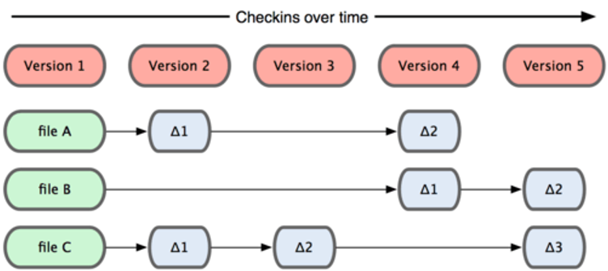
GIT AND GITHUB OVERVIEW
How Does Git Work?

Slide 36
GIT AND GITHUB OVERVIEW
How Does Git Work?
Git, however, takes a radically different stance. Instead of focusing on deltas, Git treats its data as a series of snapshots. Each time a developer commits changes, Git captures a complete picture of the project’s state at that moment—a snapshot of every file in the repository. To optimize storage, Git doesn’t redundantly save unchanged files; it creates a reference (or link) to the identical file from a previous snapshot. This snapshot-based system allows Git to efficiently manage large projects while providing rapid access to any point in the project’s history

Slide 37
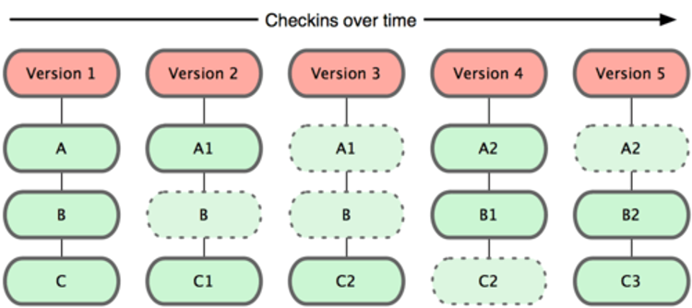
GIT AND GITHUB OVERVIEW
How Does Git Work?

Slide 38
GIT AND GITHUB OVERVIEW
How Does Git Work?
Here’s a step-by-step look at Git’s workflow:
Local Modifications: A developer edits files in their working directory.
Staging Changes: Using git add, changes are moved to the staging area (index), preparing them for the next commit.
Committing: With git commit, Git creates a snapshot of the staged changes, permanently storing it in the local repository with a unique identifier (a SHA-1 hash).
Synchronization: Changes can be pushed to a remote repository (git push) or pulled from it (git pull) to share with others.

Slide 39
GIT AND GITHUB OVERVIEW
How Does Git Work?
This snapshot model underpins Git’s strengths, such as its ability to handle branching and merging with ease. Unlike delta-based systems, which may struggle to reconcile divergent changes, Git’s snapshots provide a clear, holistic view of the project at every commit, simplifying conflict resolution and version comparison.
Visual Reference: Diagrams from StackOverflow contrast Git’s snapshot approach with the delta-based storage of traditional VCS tools, highlighting the conceptual leap.
Git’s design also imbues it with filesystem-like qualities. It’s not just a VCS but a lightweight, self-contained system with powerful tools for manipulating data, making it a versatile platform for version control and beyond.

Slide 40
GIT AND GITHUB OVERVIEW
What Are the Benefits of Using Git?
Git’s unique features translate into tangible benefits that enhance development workflows:
Team Collaboration:
In projects with multiple contributors, Git prevents code conflicts by isolating work in branches, allowing developers to merge their efforts seamlessly.
Adaptability to Change:
Software requirements often shift mid-project. Git’s versioning and branching capabilities let developers revert to earlier states or pivot to new directions without disrupting the main codebase.

Slide 41
GIT AND GITHUB OVERVIEW
What Are the Benefits of Using Git?
Robust Branching:
Git’s lightweight branching model supports parallel development—think feature experimentation, bug fixes, or release preparation—all within the same repository.
Speed and Simplicity:
Git’s commands are fast and intuitive, reducing the overhead of version control tasks.
Seamless Merging:
Combining branches is straightforward, thanks to Git’s snapshot system, which minimizes merge conflicts and simplifies integration.

Slide 42
GIT AND GITHUB OVERVIEW
What Are the Benefits of Using Git?
Offline Productivity:
Developers can clone a repository and work anywhere, committing changes locally without needing an internet connection until they’re ready to sync.
Effortless Deployment:
Git streamlines deployment by allowing precise control over which changes are pushed to production environments, reducing deployment errors.
Security and Integrity:

Slide 43
GIT AND GITHUB OVERVIEW
What Are the Benefits of Using Git?
Every commit is checksummed with a SHA-1 hash, ensuring data integrity and making tampering detectable.
These advantages make Git indispensable for modern software projects, from small scripts to enterprise-scale applications.
Key Git Terminology
To wield Git effectively, developers must grasp its foundational concepts and vocabulary:
Branch:
A separate line of development within a repository, enabling isolated work on features, fixes, or experiments.

Slide 44
GIT AND GITHUB OVERVIEW
What Are the Benefits of Using Git?
Commit:
A recorded snapshot of changes, capturing the state of the project at a specific moment, tagged with a message and metadata.
Checkout:
The process of switching to a different branch or restoring a specific commit’s state (e.g., git checkout feature-branch).
Fetch:
Retrieves updates from a remote repository without merging them, allowing inspection before integration.

Slide 45
GIT AND GITHUB OVERVIEW
What Are the Benefits of Using Git?
Fork:
A personal copy of a repository, often used for contributing to open-source projects without altering the original.
Head:
The most recent commit on the current branch, representing the active working state.
Index (Staging Area):
A buffer where changes are prepared before committing, offering flexibility to refine what’s included.
Master (or Main):
The primary branch, traditionally the stable, production-ready version of the project.

Slide 46
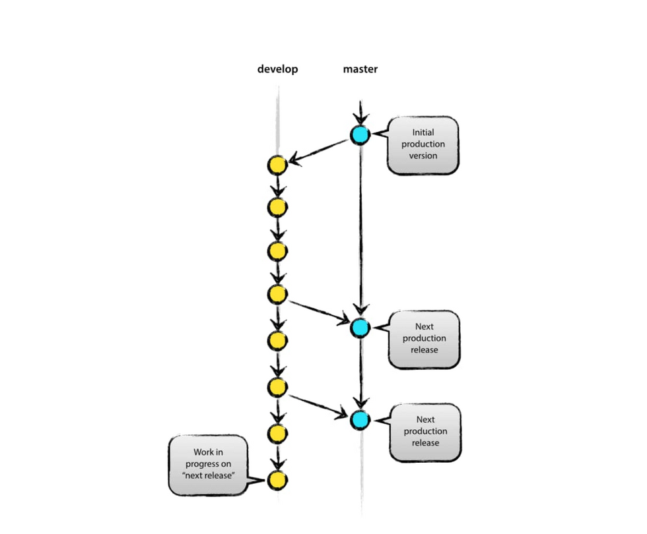
GIT AND GITHUB OVERVIEW
What Are the Benefits of Using Git?

Slide 47
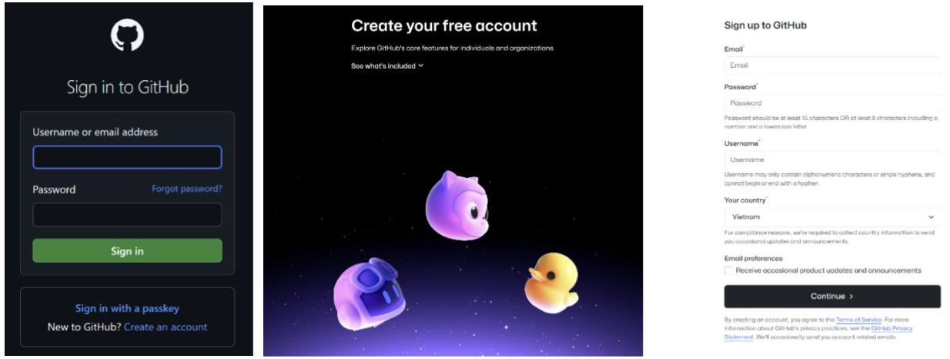
APPLY GIT/GITHUB TO PROJECTS
Git, GitHub and real application demo images
Figure 1. Sign-in and Sign-up

Slide 48
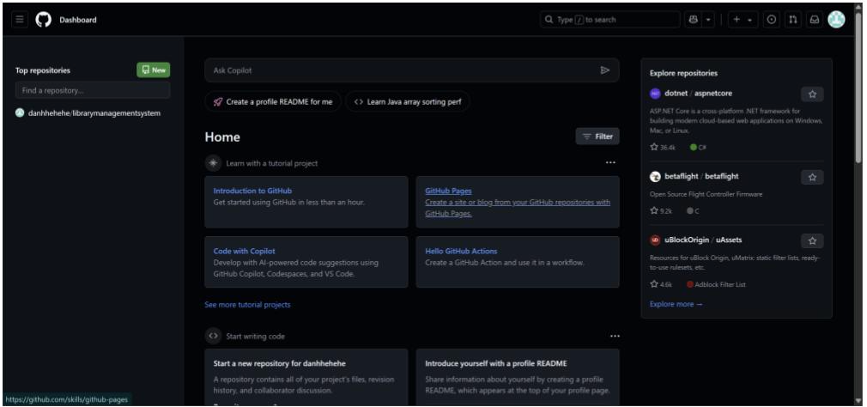
APPLY GIT/GITHUB TO PROJECTS
Git, GitHub and real application demo images
Figure 2. Home Page GitHub After logging in, you will be directed to GitHub Home page.

Slide 49
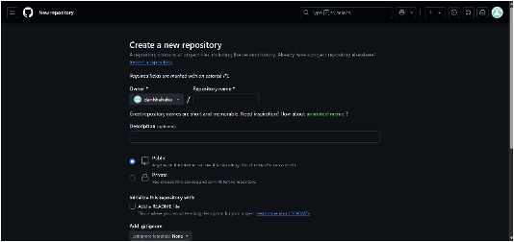
APPLY GIT/GITHUB TO PROJECTS
Git, GitHub and real application demo images
Figure 3. Create a new repository

Slide 50
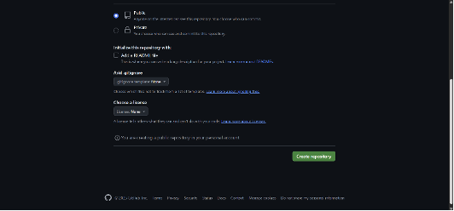
APPLY GIT/GITHUB TO PROJECTS
Git, GitHub and real application demo images
Figure 3. Create a new repository

Slide 51
APPLY GIT/GITHUB TO PROJECTS
Git, GitHub and real application demo images
When you click “New” on the home page to the “Create a new repository” interface on GitHub, you need to do the following steps to create a new repository:
Fill in the repository information:
Owner:
This field is usually pre-filled with your username or organization.
Make sure it is correct.
Repository name I will enter “librarymanagementsystem” you can enter the name of your project.
Description is a short description of your repository (optional).

Slide 52
APPLY GIT/GITHUB TO PROJECTS
Git, GitHub and real application demo images
When you click “New” on the home page to the “Create a new repository” interface on GitHub, you need to do the following steps to create a new repository:
Fill in the repository information:
Owner:
This field is usually pre-filled with your username or organization.
Make sure it is correct.
Repository name I will enter “librarymanagementsystem” you can enter the name of your project.
Description is a short description of your repository (optional).

Slide 53
APPLY GIT/GITHUB TO PROJECTS
Git, GitHub and real application demo images
When you click “New” on the home page to the “Create a new repository” interface on GitHub, you need to do the following steps to create a new repository:
Fill in the repository information:
Owner:
This field is usually pre-filled with your username or organization.
Make sure it is correct.
Repository name I will enter “librarymanagementsystem” you can enter the name of your project.
Description is a short description of your repository (optional).

Slide 54
APPLY GIT/GITHUB TO PROJECTS
Git, GitHub and real application demo images
Public or Private can be Public or Private here I will choose the default Public
Initialize the repository (optional):
Add a README file I will enter Downloaded from www.codewithc.com Thank you for using Code with C! to README. This is a text file that explains your project. It is highly recommended to add this file to make it easier for others to understand the repository.
Add .gitignore and some others I will leave as default, please fill in if required.
After filling in all the information, click the "Create repository" button. GitHub will create a new repository for you.

Slide 55
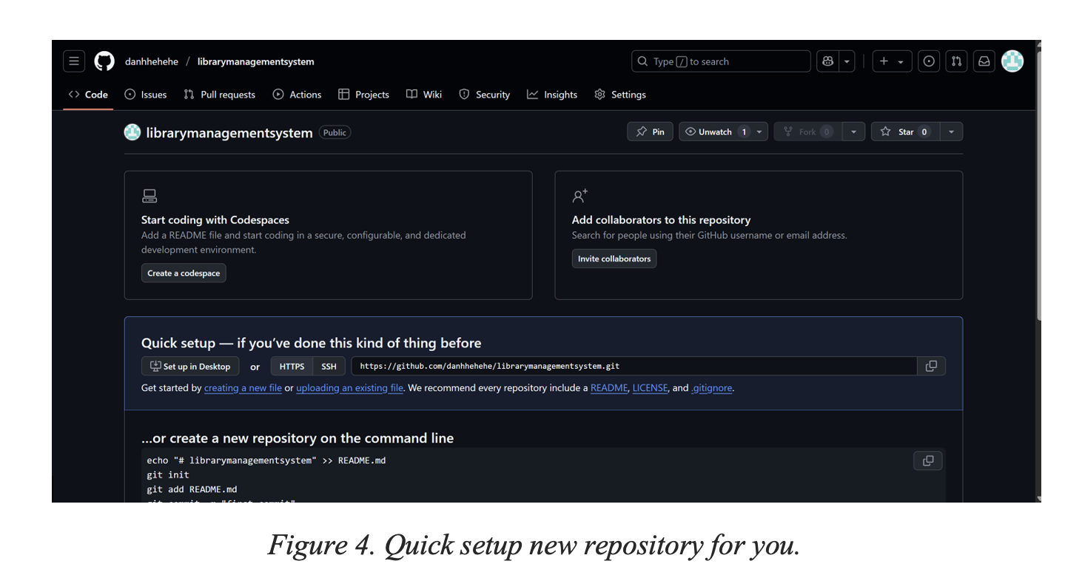
GIT, GITHUB AND APPLYING IT IN PRACTICE:

Slide 56
GIT, GITHUB AND APPLYING IT IN PRACTICE:
This interface includes settings if you have not used it before
Functional buttons:
"Pin": Pin the repository to the top of the page.
"Unwatch": Unfollow the repository.
"Star 0": Star (favorite) the repository (no one has starred it yet).
"Start coding with Codespaces" section:
Encourages the use of Codespaces to write code directly in the browser.
"Create a codespace" button: Create a Codespace environment.
"Add collaborators to this repository" section:
Allows you to add collaborators to the repository.

Slide 57
GIT, GITHUB AND APPLYING IT IN PRACTICE:
"Invite collaborators" button: Invite others to collaborate.
"Quick setup - if you've done this kind of thing before" section:
Provides options for quickly setting up the repository:
"Set up in Desktop": Set up on GitHub Desktop.
"HTTPS" or "SSH": Copy the repository URL (HTTPS or SSH).
The guide starts by creating a new file or uploading an existing one.
It is recommended to add README, LICENSE, and .gitignore files.
The "...or create a new repository on the command line" section:
Provides Git commands to create a repository on the command line:
echo "# librarymanagementsystem" >> README.md (creates a README file).
git init (initializes a Git repository).
git add README.md (adds a README file to a commit).

Slide 58
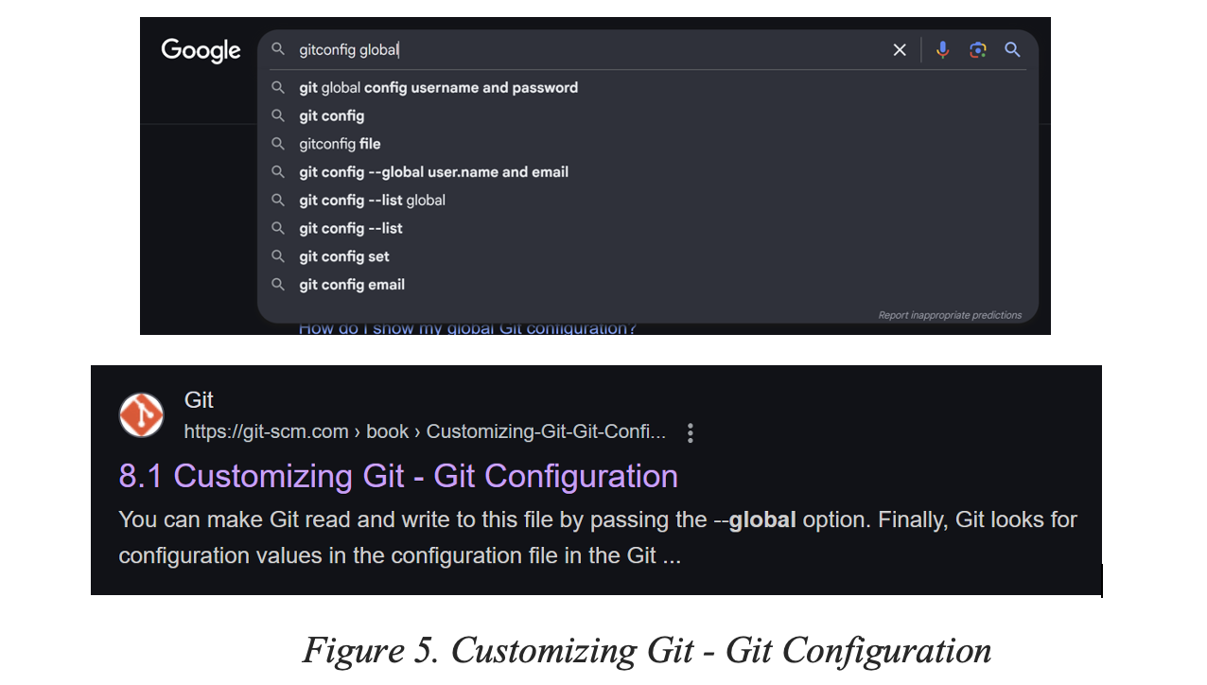
GIT, GITHUB AND APPLYING IT IN PRACTICE:

Slide 59
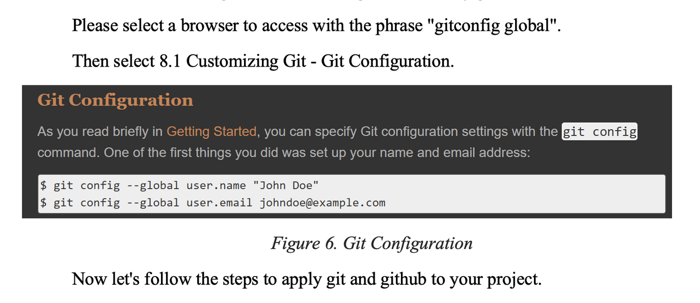
GIT, GITHUB AND APPLYING IT IN PRACTICE:

Slide 60
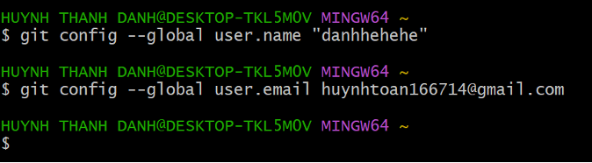
GIT CONFIGURATION
As you read briefly in Getting Started, you can specify Git configuration settings with the git config command. One of the first things you did was set up your name and email address:

Slide 61
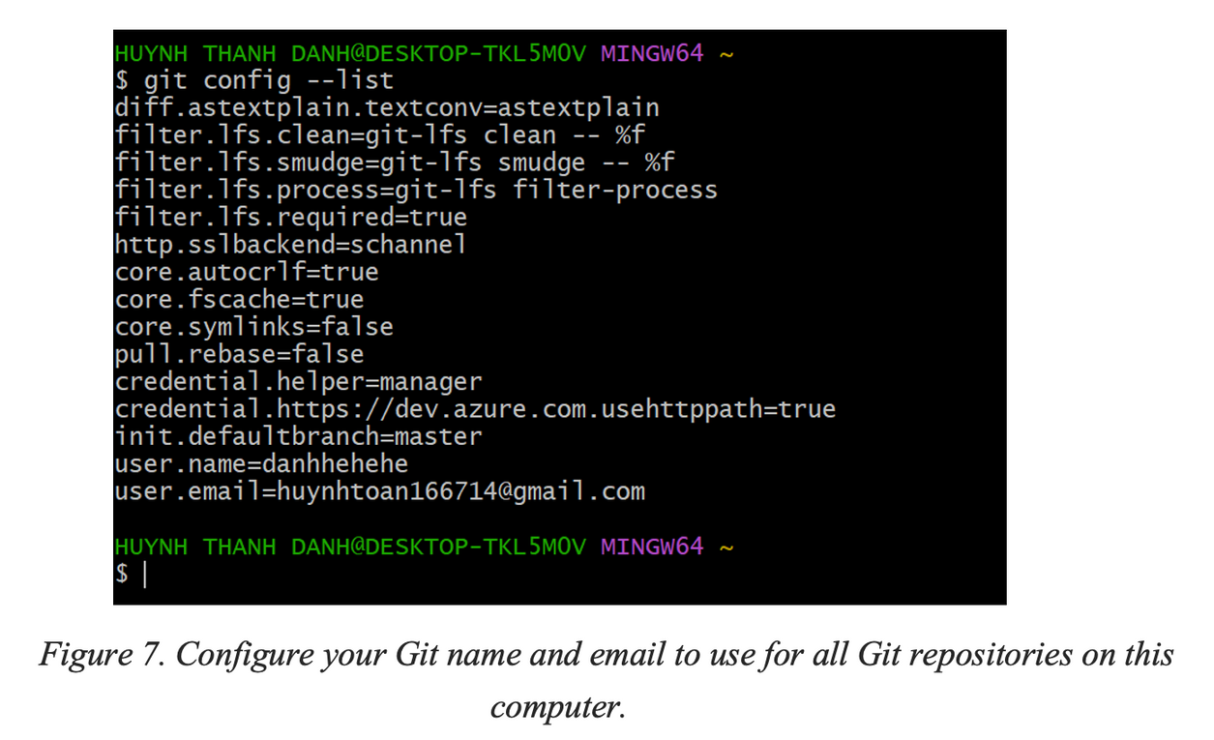
GIT CONFIGURATION

Slide 62
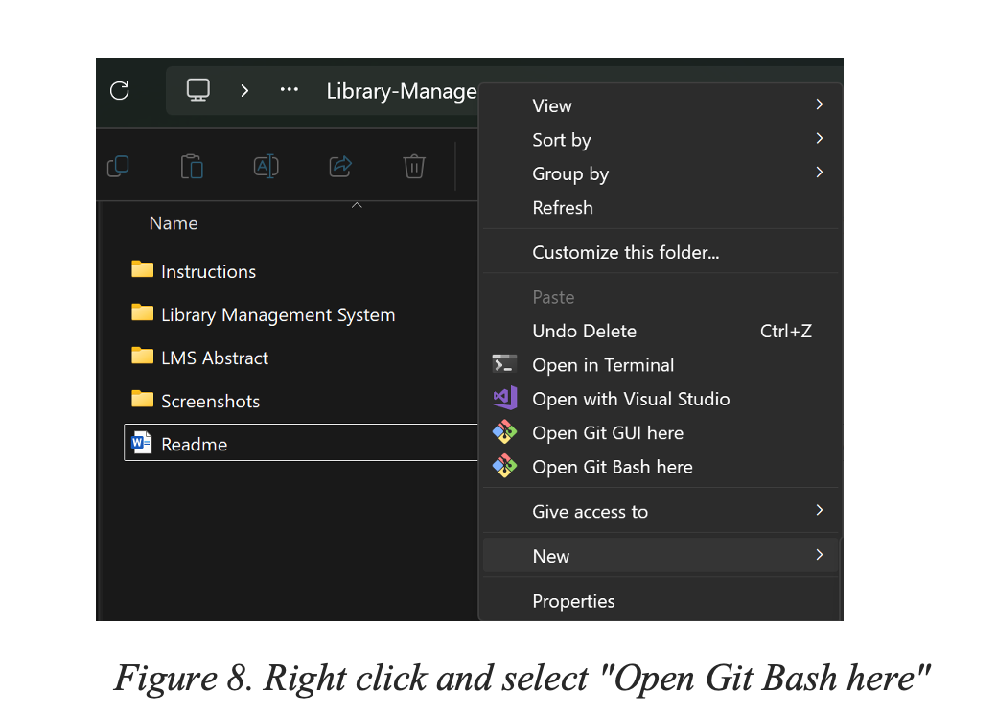
GIT CONFIGURATION

Slide 63
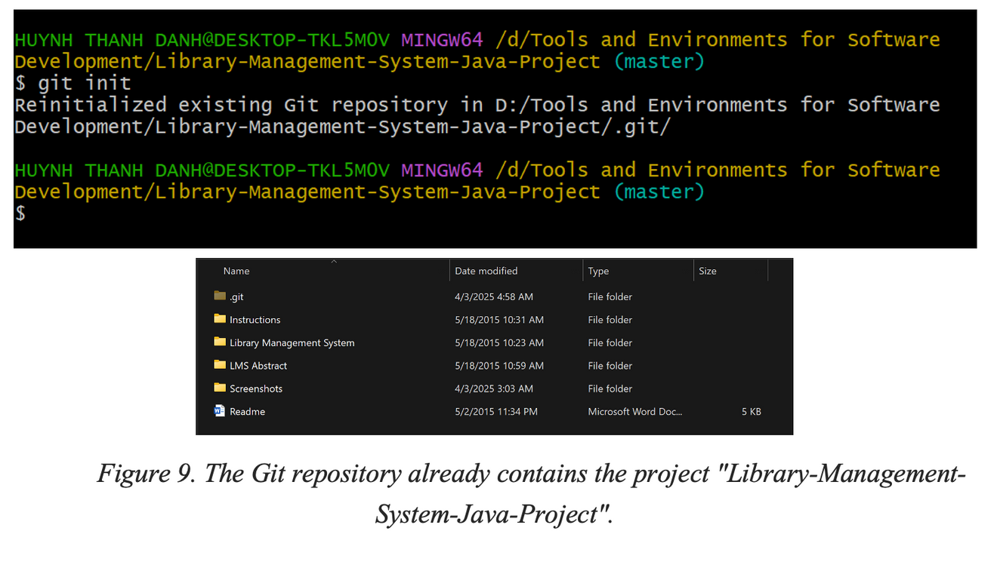
GIT CONFIGURATION

Slide 64
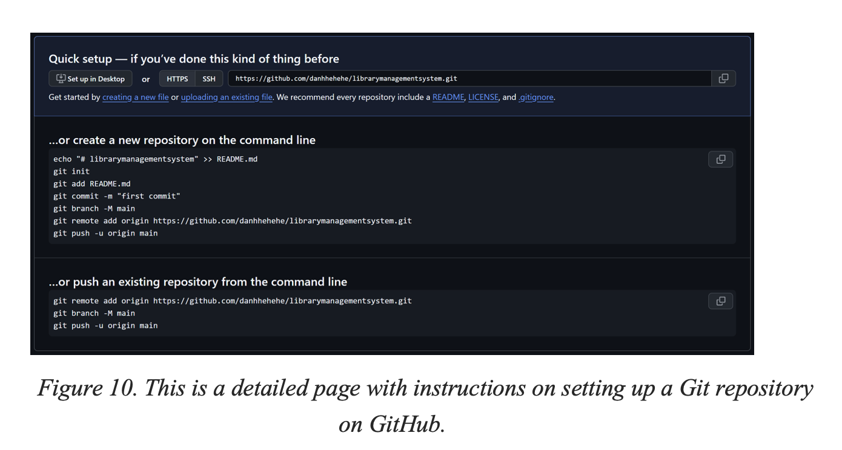
GIT CONFIGURATION

Slide 65
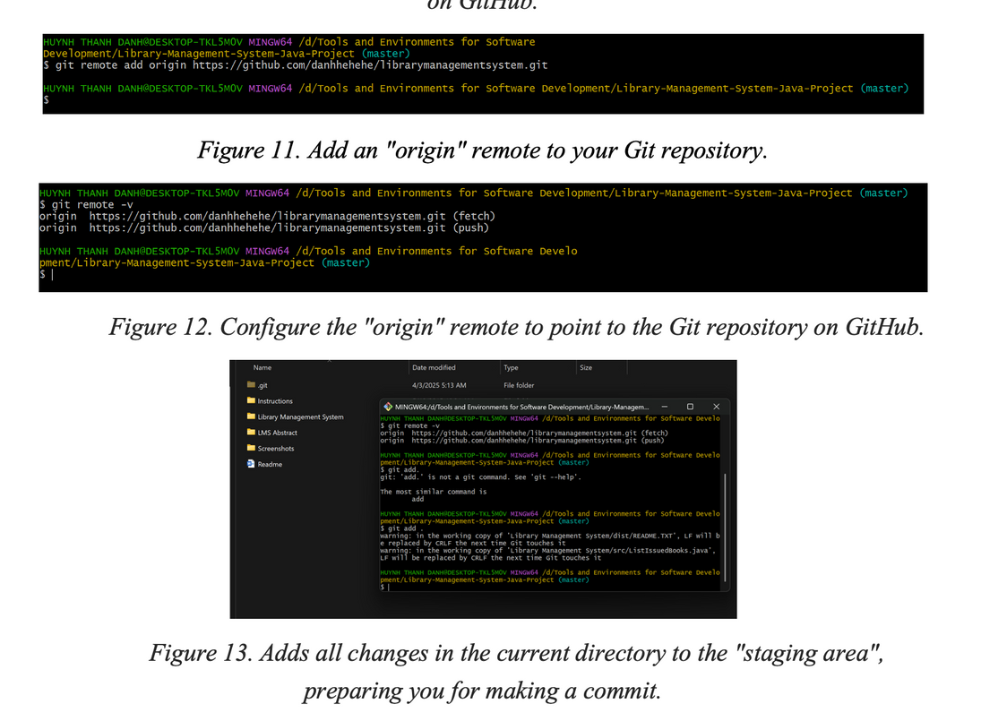
GIT CONFIGURATION

Slide 66
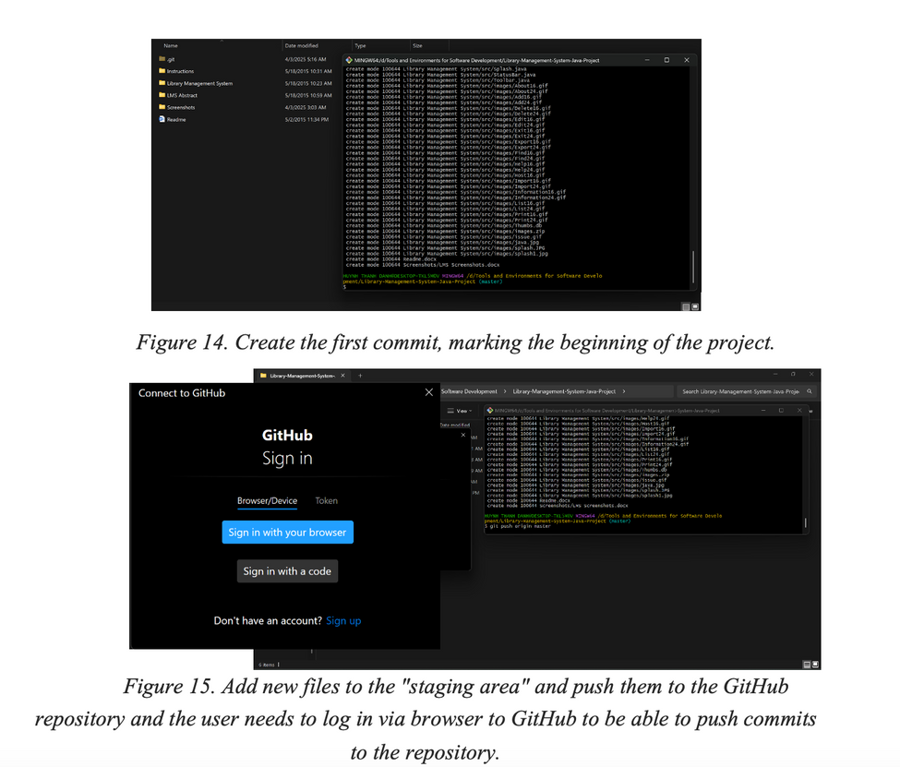
GIT CONFIGURATION

Slide 67
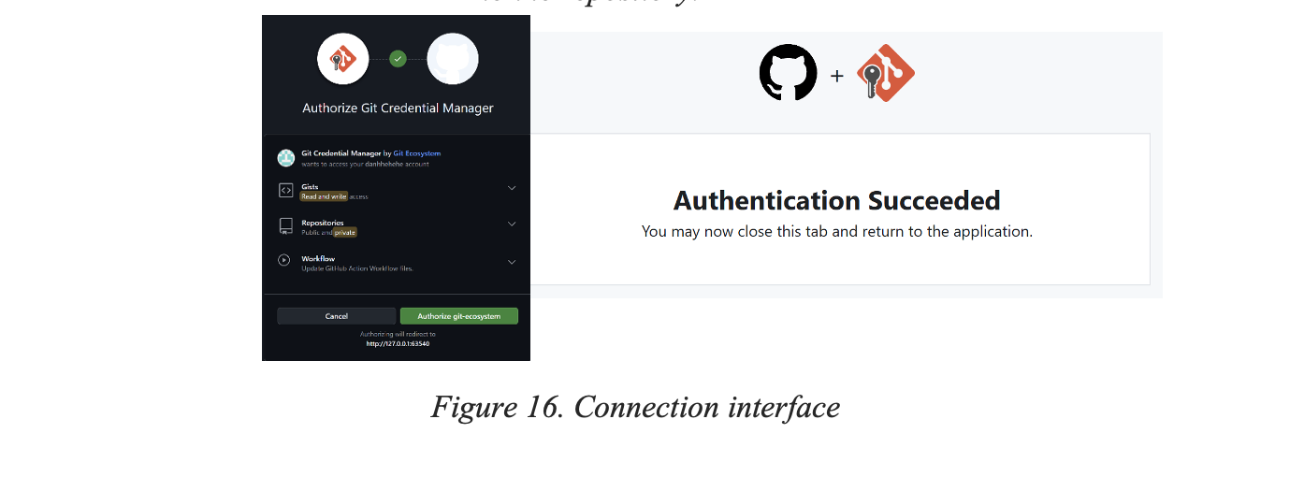
GIT CONFIGURATION

Slide 68
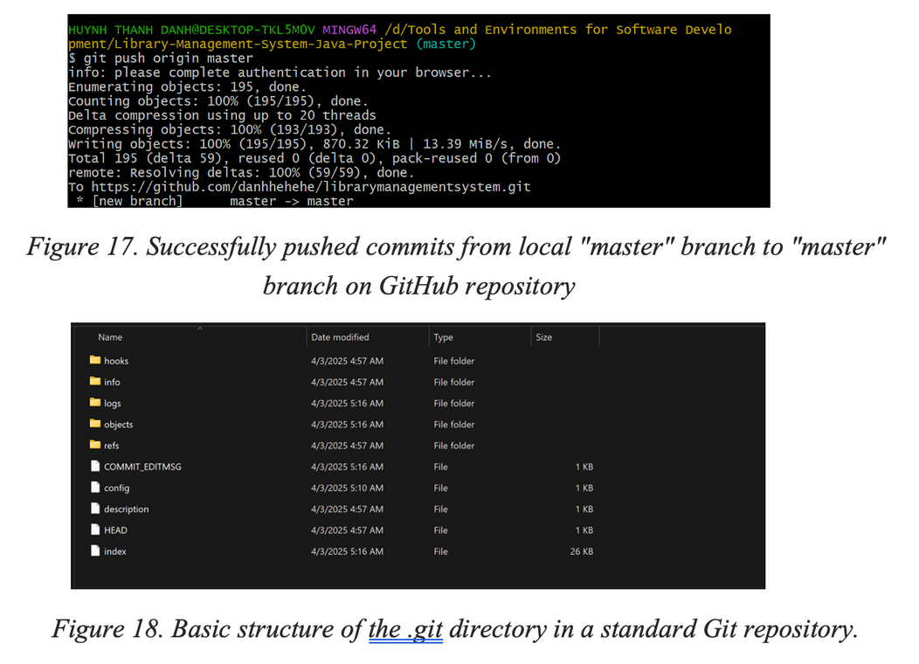
GIT CONFIGURATION

Slide 69
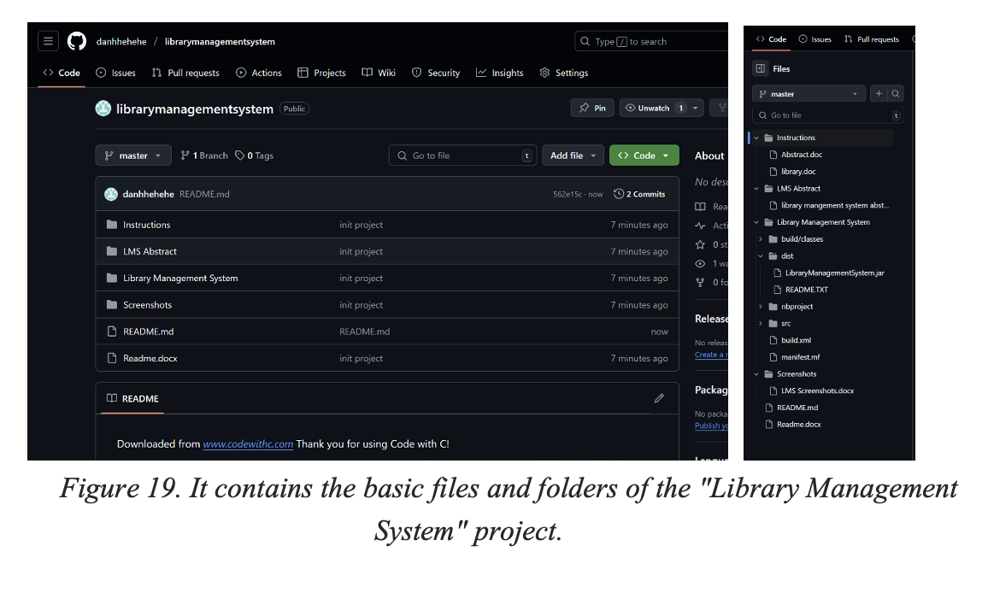
GIT CONFIGURATION

Slide 70
GIT, GITHUB AND APPLYING IT IN PRACTICE
Basic Git Commands
We'll categorize and explain the basic Git commands used in the provided log, and then discuss their practical application.
Commands Used (From the Log):
git init:
Function: Initializes a new Git repository in the current directory.
Application:
Used at the start of a new project to turn the project directory into a Git repository.
In the log, it was used (or re-used) to ensure the project was under Git version control.
git remote add origin <repository_url>:
Function: Adds a remote repository (usually on GitHub or GitLab) to your local Git repository.

Slide 71
GIT, GITHUB AND APPLYING IT IN PRACTICE
Application:
Connects your local project to a remote repository, enabling you to push and pull changes.
origin is the standard name for the main remote repository.
git remote -v:
Function: Lists the configured remote repositories, showing their names and URLs.
Application:
Used to verify that the remote repository has been added correctly.
Helps to confirm the URL of the remote.
git add <files> or git add .:
Function: Adds changes in the working directory to the staging area.

Slide 72
GIT, GITHUB AND APPLYING IT IN PRACTICE
Application:
git add <files> adds specific files.
git add . adds all changes (new, modified, deleted) in the current directory and subdirectories.
Prepares changes for the next commit.
In the log, it was used to stage all the files of the project.
git commit -m "<commit_message>":
Function: Creates a new commit with the staged changes.

Slide 73
GIT, GITHUB AND APPLYING IT IN PRACTICE
Application:
Saves a snapshot of the staged changes in the Git history.
The -m option allows you to add a commit message directly in the command.
Commit messages should be clear and concise, describing the changes made.
In the log, it was used to make the initial commit of the project.
git push origin master:
Function: Pushes the commits from the local master branch to the remote origin repository's master branch.

Slide 74
GIT, GITHUB AND APPLYING IT IN PRACTICE
git remote add origin <repository_url> to link your local repository to a remote one (e.g., on GitHub).
Make changes:
Edit, create, or delete files.
Stage changes:
git add <files> or git add . to add changes to the staging area.
Commit changes:
git commit -m "Descriptive commit message" to create a commit.
Push changes:
git push origin master to upload commits to the remote repository.

Slide 75
GIT, GITHUB AND APPLYING IT IN PRACTICE
Repeat:
Continue making changes, staging, committing, and pushing.
Additional Basic Git Commands (Not in the Log but Essential):
git status: Shows the status of the working directory and staging area.
git log: Displays the commit history.
git pull origin master: Fetches and merges changes from the remote master branch into your local master branch.
Real-World Applications of Git
Git's versatility makes it indispensable across various software development scenarios:

Slide 76
GIT, GITHUB AND APPLYING IT IN PRACTICE
Personal Software Development:
Git enables developers to track changes in their projects, revert to previous versions, and experiment with new features without risking the stability of the main codebase.
It facilitates efficient management of individual projects, allowing for organized development and easy maintenance.
Even for solo projects, Git's branching capabilities allow developers to explore different ideas without affecting the stable version of their code.
Team Collaboration:
Platforms like GitHub and GitLab leverage Git to provide robust collaboration tools.
Multiple developers can work on the same project simultaneously, with Git managing the merging of changes and resolving conflicts.

Slide 77
GIT, GITHUB AND APPLYING IT IN PRACTICE
Pull requests and code reviews facilitate a structured and transparent development process, ensuring code quality and consistency.
Git enables teams to maintain a shared, centralized repository, streamlining communication and coordination.
DevOps and CI/CD (Continuous Integration/Continuous Deployment):
Git is a cornerstone of DevOps practices, serving as the source code repository for automated build, test, and deployment pipelines.
CI/CD tools integrate with Git to trigger automated processes whenever changes are pushed to the repository.
This automation ensures rapid feedback on code changes, enabling faster and more reliable software releases.

Slide 78
GIT, GITHUB AND APPLYING IT IN PRACTICE
Git's branching model supports different deployment environments (e.g., development, staging, production).
Open Source Contributions:
GitHub has become the central hub for open-source software development.
Git allows developers to contribute to open-source projects by forking repositories, making changes, and submitting pull requests.
This fosters a collaborative environment where developers can share knowledge, improve existing software, and contribute to the community.
Understanding Git is essential for anyone wanting to participate in the open-source ecosystem.

Slide 79
CONCLUSION
By understanding how to use Git and GitHub, through lessons that Huynh Thanh Danh and the group absorbed, self-taught, and received enthusiastic guidance from teacher Nguyen Van Tan, we confidently work on large-scale projects. We contribute to open-source projects. And we understand more clearly the importance of teamwork and how crucial task allocation is. After using Git and GitHub, we have witnessed the revolution in modern software development, becoming indispensable tools for both individual developers and large teams. Their impact extends beyond simple version control, influencing how software is developed, tested, and deployed. Working with Git and GitHub is easier than traditional methods, achieving higher productivity when managing projects. Git and GitHub have fostered a vibrant open-source community, promoting collaboration and free knowledge sharing.

Slide 80
THANK YOU
Presentation by 3TL
2025

